Slide 1
Flight No | Origin | Destination | Date | Time | First Name | Last Name | Seat # | Date of Birth
Schema Definition
First Name
Last Name
Seat #
Date
Flight No
Origin
Destination
Flight No
Origin
Destination
Date
Time
First Name
Last Name
Seat #
Date of Birth
Boarding Pass
Custom Form Recognizer
Driving
License
First Name,
Last Name,
DoB
Face Pic
Built-in Id Recognizer
Emotion
30 Seconds
Video
Video Indexer
Face Pic(s)
Luggage
X-ray
Images
Custom Image/Obj Recognizer
Luggage

Slide 2






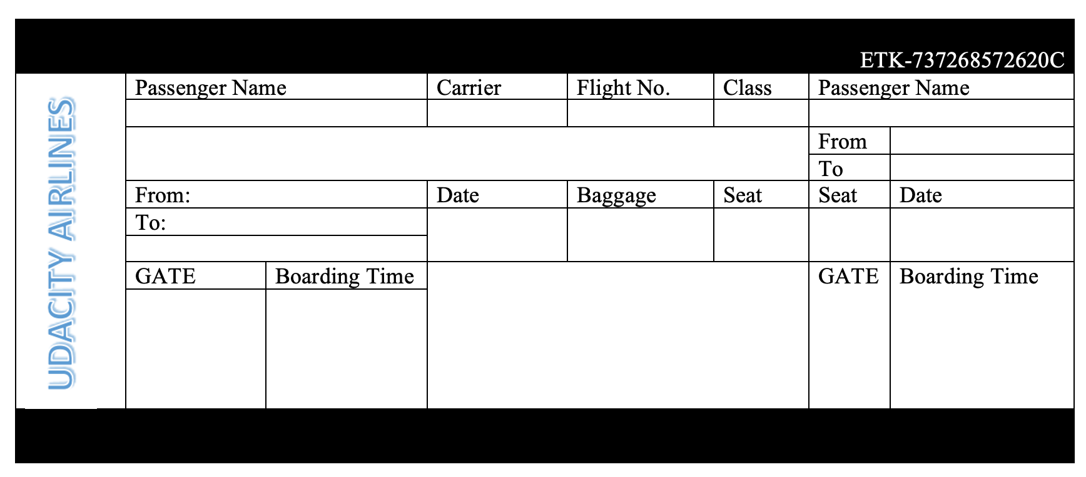
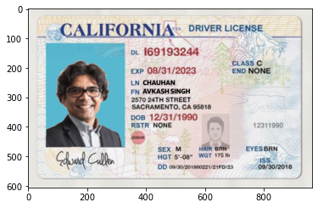
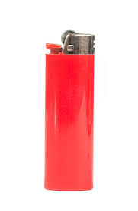
Various Azure Services and Run-time Environment
Azure
Blob
Storage
Storage
API
Kiosk
Dashboard
Azure Cloud
Processing
Engine
Form
Recognizer
Vision
API
Video
Analyzer
Face
API
Runtime: Python
Boarding Pass
Driving
License
Lighter
Images
Video
Input

Slide 3

Automated Passenger Onboarding Kiosk
Video
Analyzer
Emotion | Sentiment
Video
ID
Recognizer
ID
Name | DoB
Boarding Pass
Digital ID
Custom
Form
Recognizer
Personal Info
Flight Specific Info
Boarding Pass

Slide 4
Automated Passenger Onboarding Kiosk - Simulator
Video
Analyzer
Emotion | Sentiment
Video
ID
Recognizer
ID
Name | DoB
Custom
Form
Recognizer
Personal Info
Flight Specific Info
Boarding Pass

Slide 5

Overall Architecture
Diagram
Azure Blob
Azure Face
Azure Computer
Vision
Azure Form
Recognizer
Azure ML
Studio

Slide 7


Automated Passenger Onboarding Kiosk
Emotion | Sentiment
Video
Analyzer
Video
Identity
ID
Recognizer
ID
Name | DoB
Boarding Pass
Digital ID
Custom
Form
Recognizer
Personal Info
Flight Specific Info
Boarding Pass
Notes:
Let’s take a look at, how do we collect various types of text and image data from different input sources and combine them together to achieve our objective.
[Click]
As you can see here, the kiosk has 2 input sensors:
Camera
Image Scanner
- Boarding pass
- Digital ID
[Click] Camera is used to collect passenger video. When you will provide a 30 seconds video as input it will be considered video collected by the camera.
[Click] The image scanner scans both boarding pass and digital id.
[Click]
Both boarding pass and digital id images are the input for image scanner.
Note: We are not including the image we are using to build the lighter scanner in this section.
So, what do the kiosk does. The kiosk does the following internal processing:
[Click]
Video analyzer process Extract face image from the video and then compare it with the ID image to perform the identity validation.
Video Analyzer process also Collect passenger sentiment and emotion as automated feedback.
[Click]
ID Recognizer process collects text and face data from ID to match it with the photo extracted from the video. The text data from ID is used with boarding pass matching.
[Click]
- Boarding Pass Recognizer process extract the text data from the boarding pass and cross validate it from the flight manifest to validate boarding status.
[Click]
Video and ID analysis process gives us face images to provide digital face identification.
The face from photo id is used to cross-reference with the face extracted from the video.

Slide 8
Data Collection and Validation Process
Personal Info
Flight Specific Info
First Name
Last Name
Seat #
Date
Flight No
Origin
Destination
Flight Validation
Flight No
Origin
Destination
Date & Time
Seat No
Identity Validation
First and Last Name
Date of Birth
Mr/Mrs
Boarding Kiosk Experience
Emotion
Sentiment
Carry-on baggage Validation
Lighter Detection
First Name,
Last Name,
DoB
Face Pic
Sex
Name | DoB
Face Pic(s)
Sentiment
Emotion
Emotion | Sentiment
Public lighter images
Test Carry-on items image
Notes:
Let’s discuss the data schema from each of the input source.
[Click]
So far, we have 3 different data sources:
- ID card
- Boarding Pass
- 30-seconds video
[Click]
Information extracted from the Boarding pass gives us the following data:
- [Fields]
[Click]
Information extracted from the digital ID gives the following data:
- [Fields]
[Click]
Information extracted from the 30 second video gives us the following data:
- [Fields]
[Click]
We also have non kiosk input source data in our project.
We have lighter images to build a lighter detection model.
We also have lighter model test images to do validate model.
- [Fields]
[Click]
Based on given data from different sources, we are performing the following validations
- Flight Validation
- Identity Validation
- Boarding Experience
- Carry-on baggage Validation
[Click]
Lets see how do we perform flight validation.
As you can see the flight validation needs the following data:
- [Fields]
To collect required data for flight validation we take data from boarding and ID source.
- [field names]
[Click]
Lets see how do we perform identity validation.
As you can see the identity validation needs the following data:
- [Fields]
To collect required data for identity validation we take data from 3 different sources:
- 30 seconds video, boarding pass and digital ID source.
- [field names]
[Click]
Lets see how do we perform Boarding kiosk experience.
As you can see the Boarding kiosk experience needs the following data:
- [Fields]
To collect required data for Boarding kiosk experience we just use the 30 seconds video as our source.
- [field names]
[Click]
Finally, the carry-on baggage validation for lighter detection we use training and test images provided to you.

Slide 9
Various Azure Services and Run-time Environment
Azure
Blob
Storage
Storage
API
Processing
Engine
: Azure Cognitive Service
Form
Recognizer
Vision
Service
Video
Analyzer
Face
Service
Kiosk
Dashboard
Runtime: Python
Boarding Pass
Digital ID
Lighter
Images
Video
Input
Notes:
Lets discuss about the architecture details related to our project. Here we will learn how various Azure services and resources are going to work with your input data and assist you to validate the input information for each validation type.
[Click]
Here are 4 different kinds of input.
Boarding Pass, Digital ID as driving license, lighter images, 30-seconds video
[Click]
Next we have various Azure cognitive services required for our project
Form Recognizer
Vision Service
video Analyzer
Face Service
[Click]
all of these services are going to work together with the input data through API processing model.
[Click]
Overall Python will be used as programming language as well as your run time environment. Python is just a requirement for this project however you can use any other support language i.e. Java, NodeJS, C# etc. for this project.
[Click]
We have added the 3 layers in our architecture to show various stages of processing. These layers are
Input, Processing engine: Azure cognitive services, Storage.
Note: lets see how our input is going to work with different cognitive services in processing layer.
[Click]
- Boarding pass will be processed with Form Recognizer service
[Click]
Digital ID will be processed by 3 different services:
- form recognizer
- vision services
- face services
[Click]
- Lighter images will be processed by vision services
[Click]
Video data will be processed by 2 different services
- Video analyzer
- Face Services
---
After process layer completed it job all of these data has to be saved somewhere and we include Azure Blob services to storage all kind of data we are using in this project.
[Click] - 4 times
All the Data from processing layers stored into Azure Blob storage as persistence layer.
[Click]
Finally all of these layers generate the final kiosk message.

Slide 10

Dear Mr. Avkash Chauhan
You are welcome to flight # A123 leaving at 4:30 PM from San Francisco to Chicago.
Your seat number is A5, and it is confirmed.
We have found a prohibited item into your carry-on baggage, and it is flagged for removal.
Your identity is verified so please board the plane.

